Slide 1
The Tweets Classification

Slide 2
Quick Overview
SMS SPAM Dataset is used to train model
https://www.kaggle.com/datasets/uciml/sms-spam-collection-dataset
The dataset is cleaned, stop words are removed, lemmatized and tokenized for vectorization and analysing.
TF-IDF Vectorization is used.
https://www.linkedin.com/learning-login/share?account=2169170&forceAccount=false&redirect=https%3A%2F%2Fwww.linkedin.com%2Flearning%2Fnlp-with-python-for-machine-learning-essential-training%2Finverse-document-frequency-weighting%3Ftrk%3Demail_share

Slide 3
Model Training and Evaluation
Random Forest Model is used.
Dataset is split into test and training set on 20%.
Precision: 0.97
Recall: 0.87
Accuracy: 0.97

Slide 4
Tweet Analysis
The Ukraine and Russia war have got a huge support on the Social Media Platform.
Let’s assess the sentiment of the people around the world on the topic.
Also, Let’s check the authenticity of the tweets by classifying Not SPAM/ SPAM tweets.
Key words:
Ukraine
Russia
War
Total 45937 tweets have been scraped on the topic Ukraine and Russia War

Slide 5
SPAM Classified Tweets
Does everyone know why China ðŸ‡¨ðŸ‡³ war with Taiwan ðŸ‡¹ðŸ‡¼? And Russia ðŸ‡·ðŸ‡º war with Ukraine ðŸ‡ºðŸ‡¦? Because Obama stole my seat in 2012. Trump stole my seat in 2016. Biend stole Presidential seat in 2021 from President Prince Seng Heng. If Biend gives seat back to me the war will the end.
International case study ..even it need in reecent time. Example doklam issue Sevene sister issue Russia Ukraine war S 400 deal etc.
The war in Ukraine was supposed to happen in 2016, after Hillary Clinton won. The Trump/Russia hoax was a response to justify why she didn't win.

Slide 6
SPAM Tweet
Tweet
Uncivilized Russia just killed 50 Ukrainian prisoners of war with a missile fired at the prison they were held at , primitive Russia needs to pay for these atrocities they are committing in Ukraine !
Sources sound different
https://www.telesurenglish.net/news/Russian-MoD-50-Ukrainian-Officers-Killed-in-Long-Range-Strike-20220619-0023.html
https://www.tasnimnews.com/en/news/2022/06/19/2731013/russia-says-over-50-ukrainian-generals-officers-killed-in-missile-strike
https://www.aa.com.tr/en/russia-ukraine-war/over-50-ukrainian-prisoners-of-war-reportedly-killed-in-shelling/2648513

Slide 7
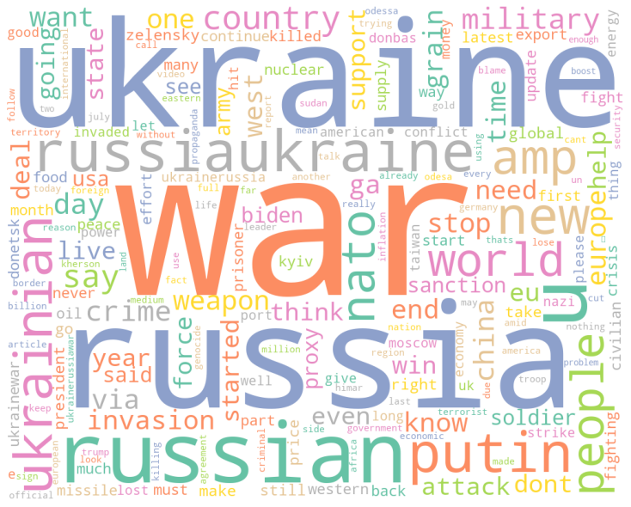
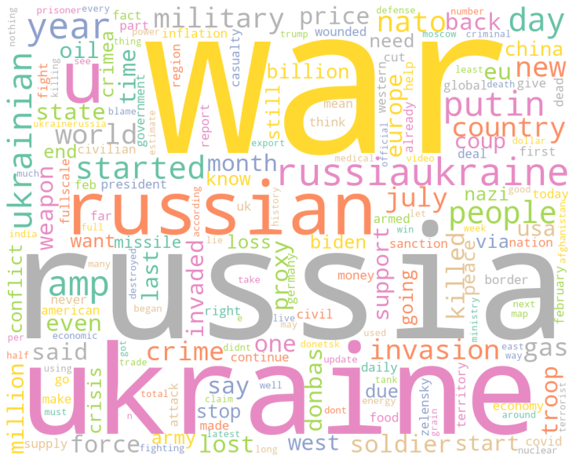
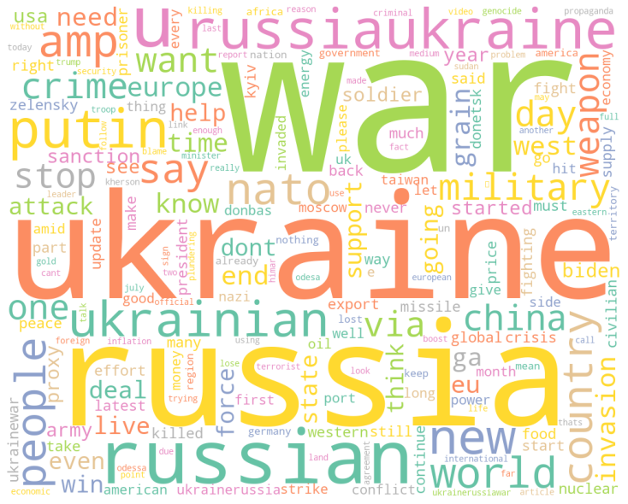
Word cloud Analysis
Overall, tweet analysis
SPAM tweet analysis
Not SPAM tweet analysis

Slide 8
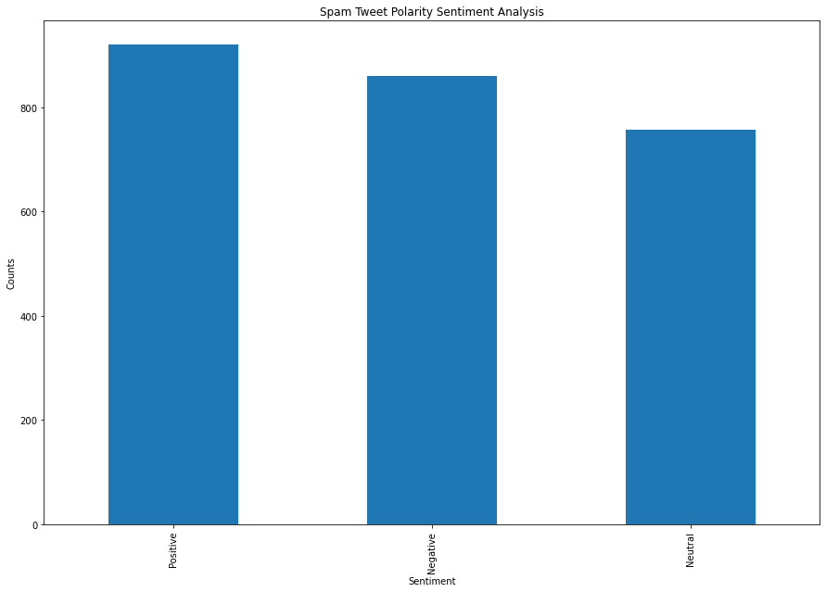
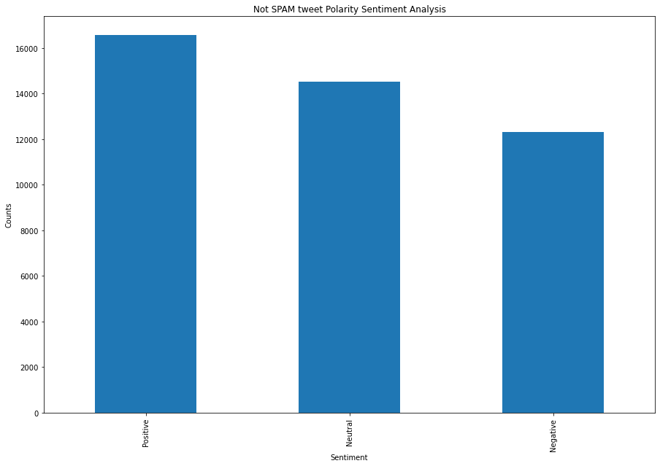
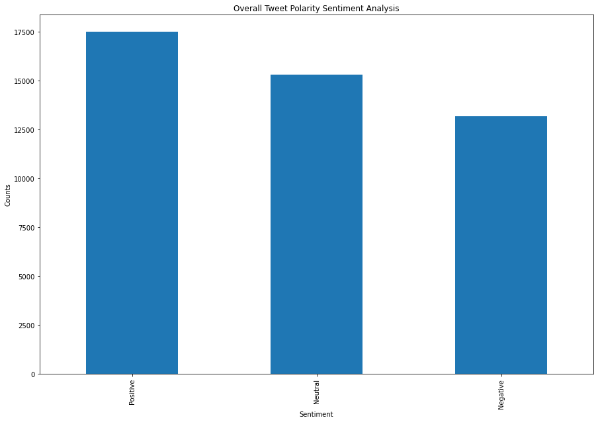
Polarity Sentiment Analysis
SPAM
Over all Tweet SPAM
Not SPAM

Slide 9
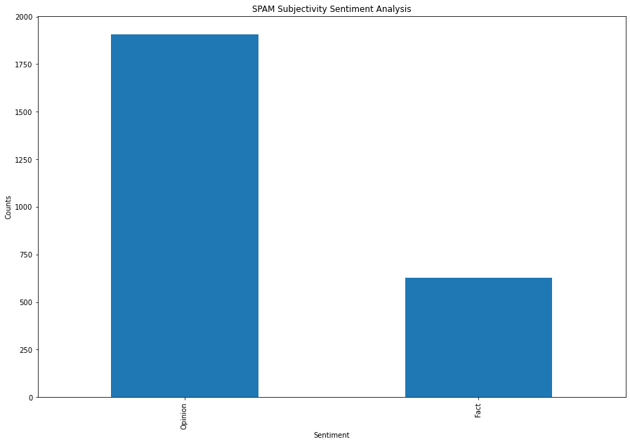
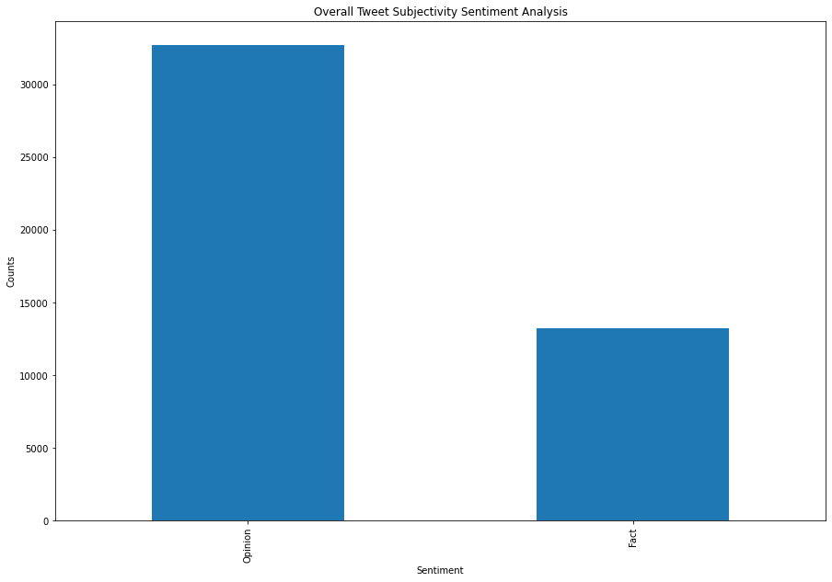
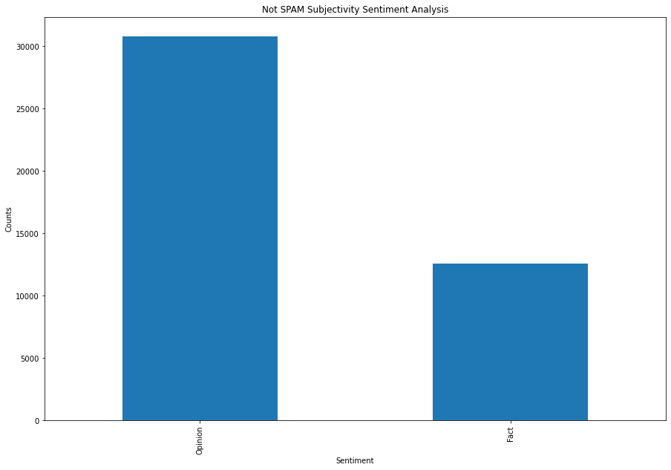
Subjectivity Analysis
SPAM
Over all Tweet SPAM
Not SPAM

Slide 10
Thank you…

